Slide 1
Road Marking Segmentation
CSE641: Computer Vision: Modern Methods and Applications
School of Engineering and Applied Science, Ahmedabad University
Team: TechTitans
Megh Patel | Devanshi Pathak | Dharmi Vekariya | Konark Karia
AU2544020 | AU2544014 | AU2544029 | AU2544011

Slide 2
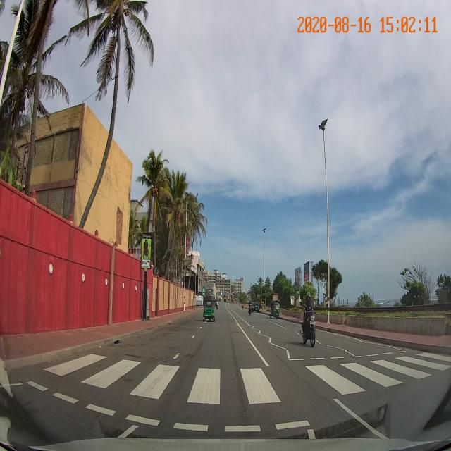
Motivation
Safety:
Accurate road marking detection is critical for ADAS and autonomous vehicle navigation.
Infrastructure:
Indian roads present unique challenges like weathered markings and non-standard layouts.
Precision:
Semantic segmentation provides much finer detail than simple bounding-box detection.
Our motivation stems from the need for reliable lane discipline in complex traffic. We aim to identify every pixel of road markings to ensure vehicles stay within safe boundaries.

Slide 3
Problem Statement
Goal:
Benchmark state-of-the-art models for diverse road marking identification.
Challenge:
Varying lighting, road qualities, and complex marking types (zebra, broken, solid).
Scope:
Training on ground-level imagery to build a robust feature extractor.
Brief Description:
The current problem is identifying diverse markings accurately under real-world conditions. We are evaluating which architecture (CNN or Transformer) handles these variations better.

Slide 4
Data Description: CeyMo Dataset
Focus:
Large-scale multi-view dataset for Indian road markings.
Volume:
2,800+ high-resolution images.
Diversity:
Covers urban, rural, and highway environments.
We used the CeyMo dataset because it captures the specific "domain" of Indian roads. It provides the high-quality pixel-level masks necessary for training deep segmentation models.
Classes
1. Bus lane
2. Yellow Markings
3. Line 1
4. Line 2
5. Crossing
6. Romb
7. Slow
8. Left Arrow
9. Forward Arrow
10. Forward Arrow - Left
11. Forward Arrow - Right
12. Right Arrow
13. Bicycle

Slide 5
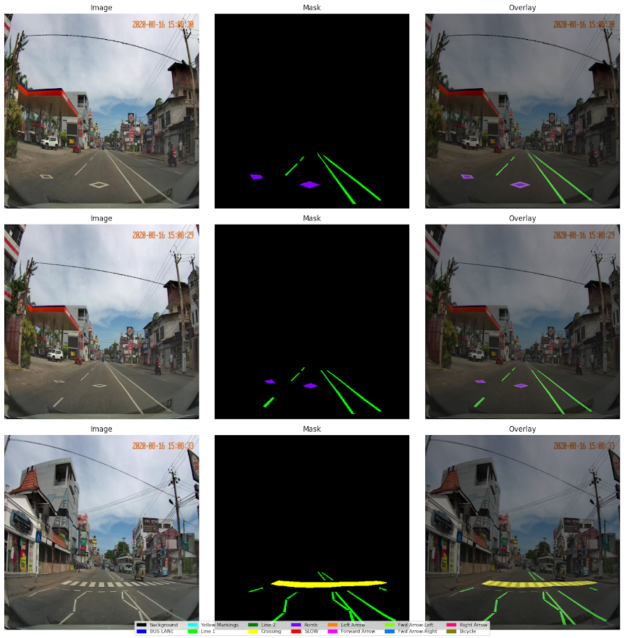
Sample Data Visuals
Image, Mask and Overlay:
We mapped the masks along with the road marking images in-order to make our model understandable
Visual Alignment Check:
Verified masks against real-world features.

Slide 6
Literature Review
DeepLab V3+:
Uses ASPP for multi-scale road markings
Atrous convolution expands the field of view
Captured fine details with encoder-decoder structure
CeyMO:
Primary dataset for training 11 categories
Identifies domain gap in UAV views
Provides diverse annotations for complex scenarios
Segformer:
Transformer-based for capturing long lane lines
No position encodings for resolution flexibility
Lightweight MLP decoder improves computational efficiency
Feature Fusion:
Integrated scales for non-linear marking accuracy
Supported project's ensemble model strategy
Combined markings for complete right-of-way data

Slide 7
Methodology: Framework & Tools
Core Library: OpenMMLab’s MMSegmentation
Language & Backend: Python, PyTorch
Hardware: Google Colab (GPU-accelerated)
Our technical stack relies on MMSegmentation for its modularity. This allows us to easily swap backbones and compare different architectures like SegFormer and DeepLabV3+ within the same pipeline

Slide 8
Method 1: DeepLabV3+ (CNN-Based)
Architecture: Uses ResNet-50 as a backbone for feature extraction
Innovation: Atrous Spatial Pyramid Pooling (ASPP)
Strengths: Captures multi-scale features by using different dilation rates
DeepLabV3+ is our CNN baseline. It excels at maintaining spatial resolution, which is vital for detecting thin, long structures like solid lane lines.

Slide 9
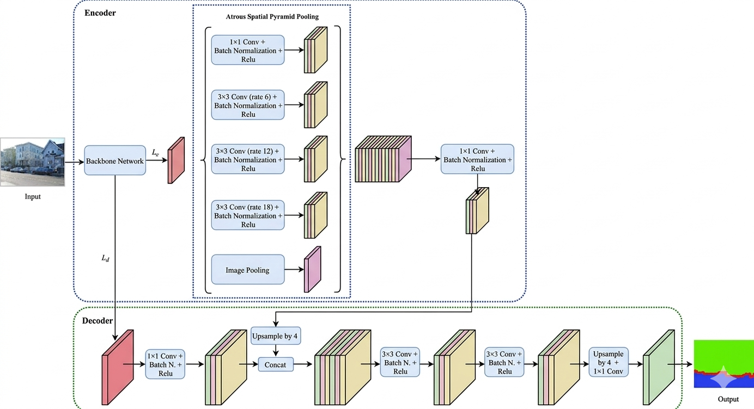
DeepLabV3+ (CNN-Based) Architecture

Slide 10
Method 2: SegFormer (Transformer-Based)
Architecture:
Hierarchical Transformer encoder + Lightweight MLP decoder
Key Advantage:
Positional encoding-free; handles various resolutions efficiently
Strengths:
Captures long-range dependencies and global context.
SegFormer represents the latest shift toward Transformers in vision. It is more efficient than CNNs and better at understanding the overall "flow" of the road markings in a scene.

Slide 11
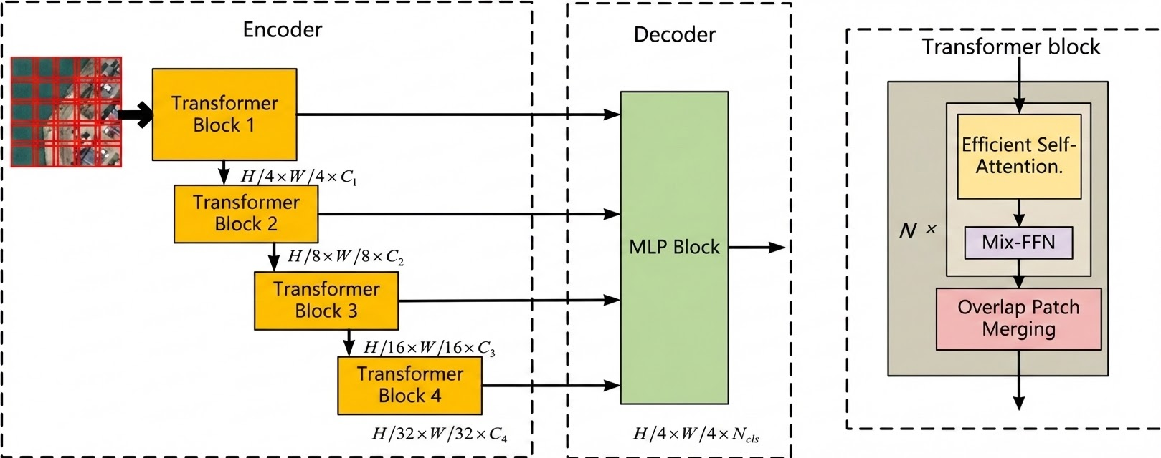
SegFormer (Transformer-Based) Architecture

Slide 12
Methodology Explanation: Training Pipeline
Optimizer: AdamW with a weight decay of 0.01
Learning Rate: "Poly" schedule for smooth convergence
Augmentation: Random Resizing, Horizontal Flipping, and Photo Metric Distortion
Loss Function: Cross-Entropy Loss to optimize pixel accuracy
To make the models robust, we applied heavy data augmentation. This ensures that the models can handle different perspectives and image qualities effectively during testing.

Slide 13
Ensemble Strategy: SegFormer + DeepLabV3+
Approach Overview
Combines the global context-awareness of Transformers (SegFormer) with the local spatial precision of CNNs (DeepLab V3+).
Ensemble Logic: Employs a Weighted Soft-Voting mechanism.
Instead of hard labels, the raw probability maps (logits) from both models are extracted.
Logits are averaged or weighted to produce a final refined prediction mask, reducing the individual errors of each architecture.

Slide 14
Results: Quantitative Analysis
Metric: Mean Intersection over Union (mIoU)
SegFormer: Higher performance on complex patterns (Zebra/Arrows)
DeepLabV3+: Consistent results on standard linear markings
Efficiency: SegFormer achieved higher accuracy with fewer parameters
Quantitatively, SegFormer excels in complex pattern understanding, while DeepLabV3+ achieves higher overall mIoU due to its stability and strong multi-scale feature extraction.

Slide 15
Results: SegFormer
0.0020
Baseline (Zero-Shot)
0.5341
Fine-tuned mIoU
0.5321
Improvement
Key Takeaway from Segformer
High IoU for large-contrast classes (Crossing, Yellow Lines)
Low IoU for thin geometries (Line 2: 0.2385)
Orientation variants harder to distinguish (Fwd-Right: 0.144)
Fine-tuning improved mIoU by 27× over zero-shot baseline

Slide 16
Results: DeepLabV3+
0.6605
Baseline (Zero-Shot)
0.6716
Fine-tuned mIoU
0.0111
Improvement
Key Takeaway from DeepLab V3+
Excellent background segmentation (0.989)
Robust on Yellow Markings & Crossings
Bicycle class lowest (0.316) — complex geometry
Strong consistency across directional arrows
ASPP effective for multi-scale road signs

Slide 17
Results: Ensembled Method
0.6628
Best Ensembled IoU
-0.0088
Improvement
Key Takeaway from Ensemble Method
The ensemble method achieved an mIoU of 0.6628, effectively bridging the gap between the two models.
Significant performance gains in detecting complex markings like "Forward Arrow" (+0.0067) and "Left Arrow" (+0.0112) compared to single-model benchmarks.
The ensemble is particularly robust against "weathered" or "non-standard" Indian road markings where single architectures often struggle with false positives.

Slide 18
Ensemble - Results
Class | Segformer | DeepLab V3+ | Ensembled | Δ vs best
background | 0.0000 | 0.9898 | 0.9907 | +0.0009 (DL)
BUS LANE | 0.7777 | 0.7236 | 0.7780 | +0.0003 (SF)
Yellow Markings | 0.8926 | 0.8142 | 0.8774 | -0.0152 (SF)
Line 1 | 0.5895 | 0.5166 | 0.5132 | -0.0763 (SF)
Line 2 | 0.2385 | 0.4426 | 0.4349 | -0.0077 (DL)
Crossing | 0.7429 | 0.7708 | 0.7708 | +0.0000 (DL)
Romb | 0.5913 | 0.7821 | 0.7821 | +0.0000 (DL)
Test mIoU | 0.4959 | 0.6716 | 0.6628 | -0.0088

Slide 19
Ensemble - Results
Class | Segformer | DeepLab V3+ | Ensembled | Δ vs best
SLOW | 0.5584 | 0.6452 | 0.6456 | +0.0004 (DL)
Left Arrow | 0.4944 | 0.7310 | 0.7421 | +0.0112 (DL)
Forward Arrow | 0.6614 | 0.7021 | 0.7087 | +0.0067 (DL)
Forward Arrow -Left | 0.4917 | 0.6776 | 0.4205 | -0.2572 (DL)
Forward Arrow -Right | 0.3192 | 0.6816 | 0.6833 | +0.0017 (DL)
Right Arrow | 0.5852 | 0.6592 | 0.6658 | +0.0066 (DL)
Bicycle | 0.0003 | 0.2663 | 0.2658 | -0.0005 (DL)
Test mIoU | 0.4959 | 0.6716 | 0.6628 | -0.0088

Slide 20
Key Takeaways & Conclusion
DeepLabV3+ (mIoU 0.6716) outperforms SegFormer (0.4959) on CeyMo — ASPP is effective for structured road marking patterns.
Fine-tuning provides significant uplift: SegFormer improved from near-zero to 0.4959; marginal but consistent gain for DeepLabV3+.
High-contrast, large-area classes (Crossings, Yellow Markings) are easiest; thin or rare classes (Bicycle, Line 2) remain challenging.
Both models show potential as a pre-training foundation for domain adaptation to aerial (UAV) imagery.
MMSegmentation + PyTorch pipeline is a robust, scalable framework for future dataset extensions and model upgrades.

Slide 21
Future Enhancements
Resolution tuning: From the survey it was noticed that the Segformer model performs pretty well on large scale input, so we’ll try to tune the image resolution from 512x512 to 1024x1024 pixels.
Advanced Augmentations: Moving beyond just flipping and brightness adjustment we can also add color jitter, random cropping, blur etc.
Backbone Upgrade: Upgrading the backbone model in DeepLab V3+ from Resnet to Xceptionet (helps in spatial encoding tasks).
Loss Function Implementation: Use a combination of Distance-based Boundary Loss and Regional Loss (currently used) in both models to make sure predicted masks match or mimic the boundary pattern of the ground truth.
Transfer Learning: As soon as we achieve expected results, we would perform transfer learning on VisDrone Dataset and fine-tune the model as per the requirement.

Slide 22
References
[1] Chen, L. C., Papandreou, G., Kokkinos, I., Murphy, K., & Yuille, A. L. (2017). Deeplab: Semantic image segmentation with deep convolutional nets, atrous convolution, and fully connected crfs. IEEE transactions on pattern analysis and machine intelligence, 40(4), 834-848.
[2] Jayasinghe, O., Hemachandra, S., Anhettigama, D., Kariyawasam, S., Rodrigo, R., & Jayasekara, P. (2022). Ceymo: See more on roads-a novel benchmark dataset for road marking detection. In Proceedings of the IEEE/CVF Winter Conference on Applications of Computer Vision (pp. 3104-3113).
[3] Xie, E., Wang, W., Yu, Z., Anandkumar, A., Alvarez, J. M., & Luo, P. (2021). SegFormer: Simple and efficient design for semantic segmentation with transformers. Advances in neural information processing systems, 34, 12077-12090.
[4] He, Z., Gan, Z., Gong, P., Li, M., & Li, K. (2024). Research on traffic marking segmentation detection algorithm based on feature fusion. World Electric Vehicle Journal, 15(11), 497.
[5] Jayasinghe, O., Hemachandra, S., Anhettigama, D., Kariyawasam, S., Rodrigo, R., & Jayasekara, P. (2022, January). CeyMo: See more on roads - A novel benchmark dataset for road marking detection. In *Proceedings of the IEEE/CVF Winter Conference on Applications of Computer Vision (WACV)* (pp. 3104–3113).

